Slide 2
International congresses of Historical sciences
The Congresses take place every 5 years in different parts of the world.
International Committee of Historical Sciences/Comité International des Sciences Historiques (CISH) (www.cish.org)
The association of historians from all over the world, established in Geneva in 1926.
It is composed of national committees, international organizations devoted to research in all areas of historical study and affiliated commissions.
The First International Congress of Historical Sciences – 1900 in Paris.
It is the biggest world meeting of the international community of historians and the best opportunity to present and discuss the most topical themes.

Slide 3
International congress of Historical sciences 1933
So far, in Poland, the Congress was held only once, in 1933 in Warsaw.

Slide 4
organizational structure

Slide 5
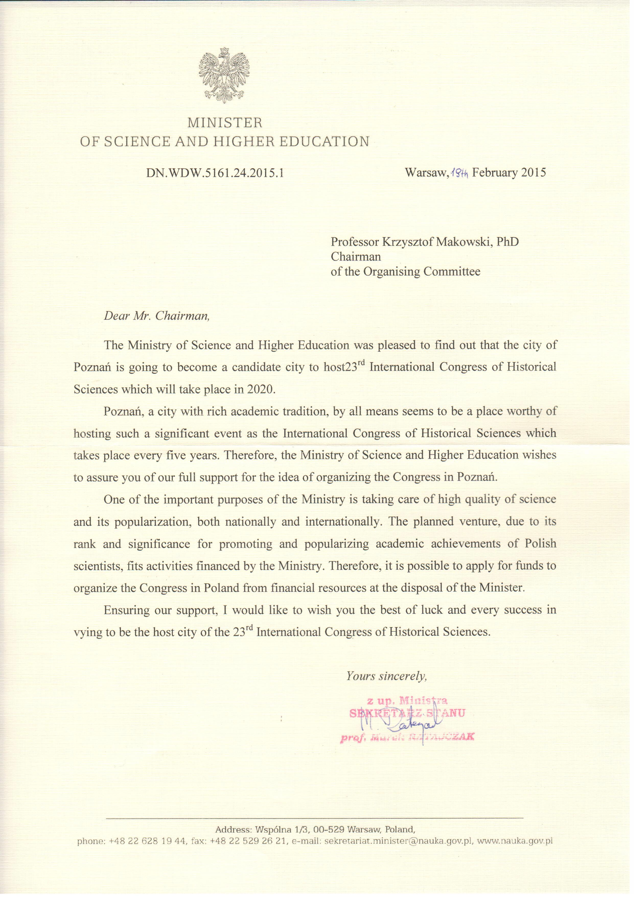
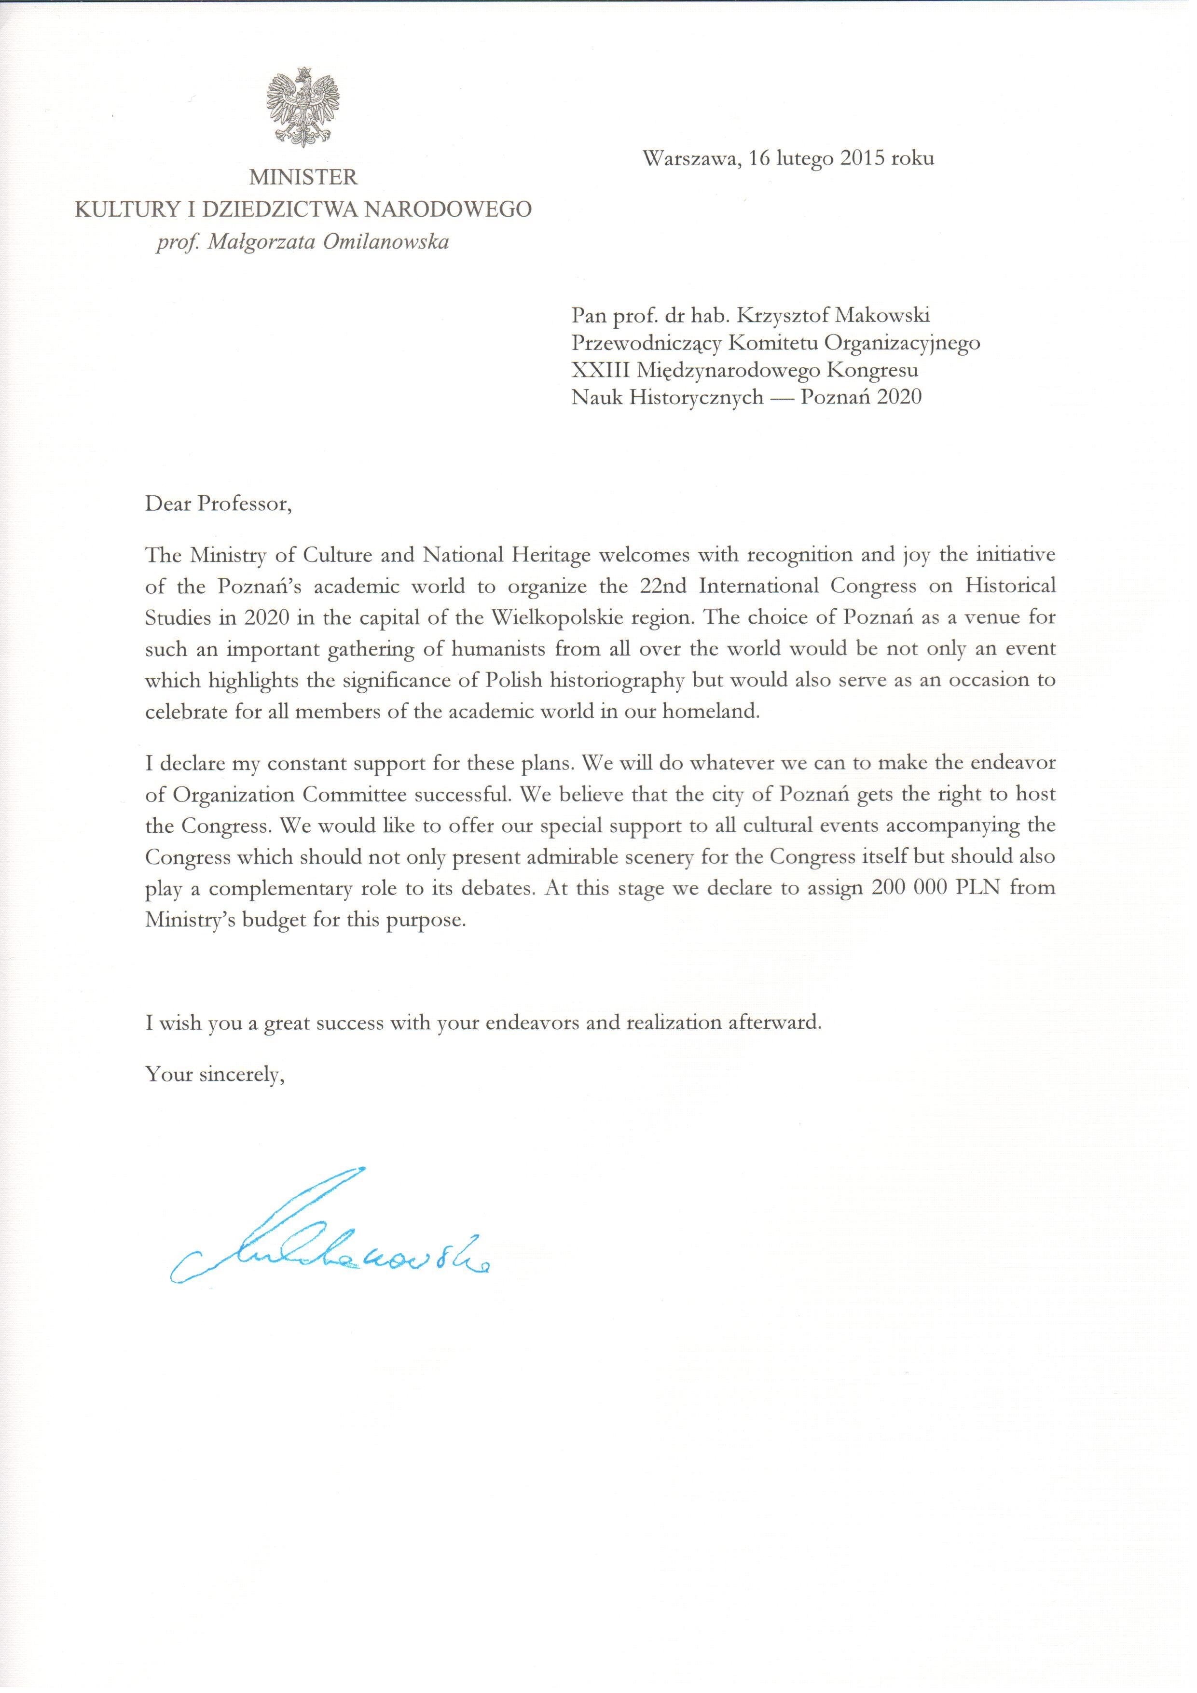
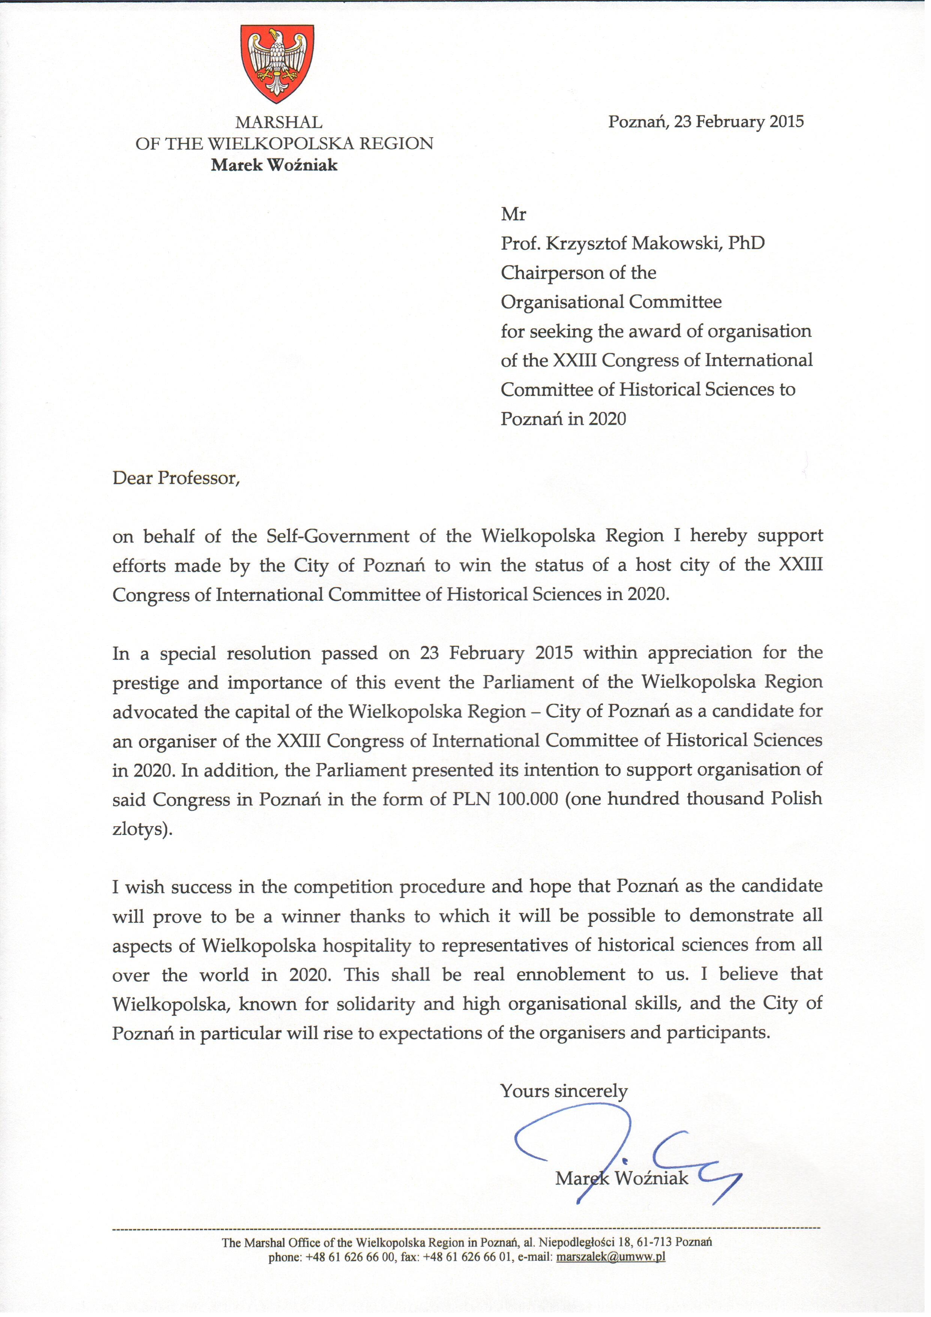
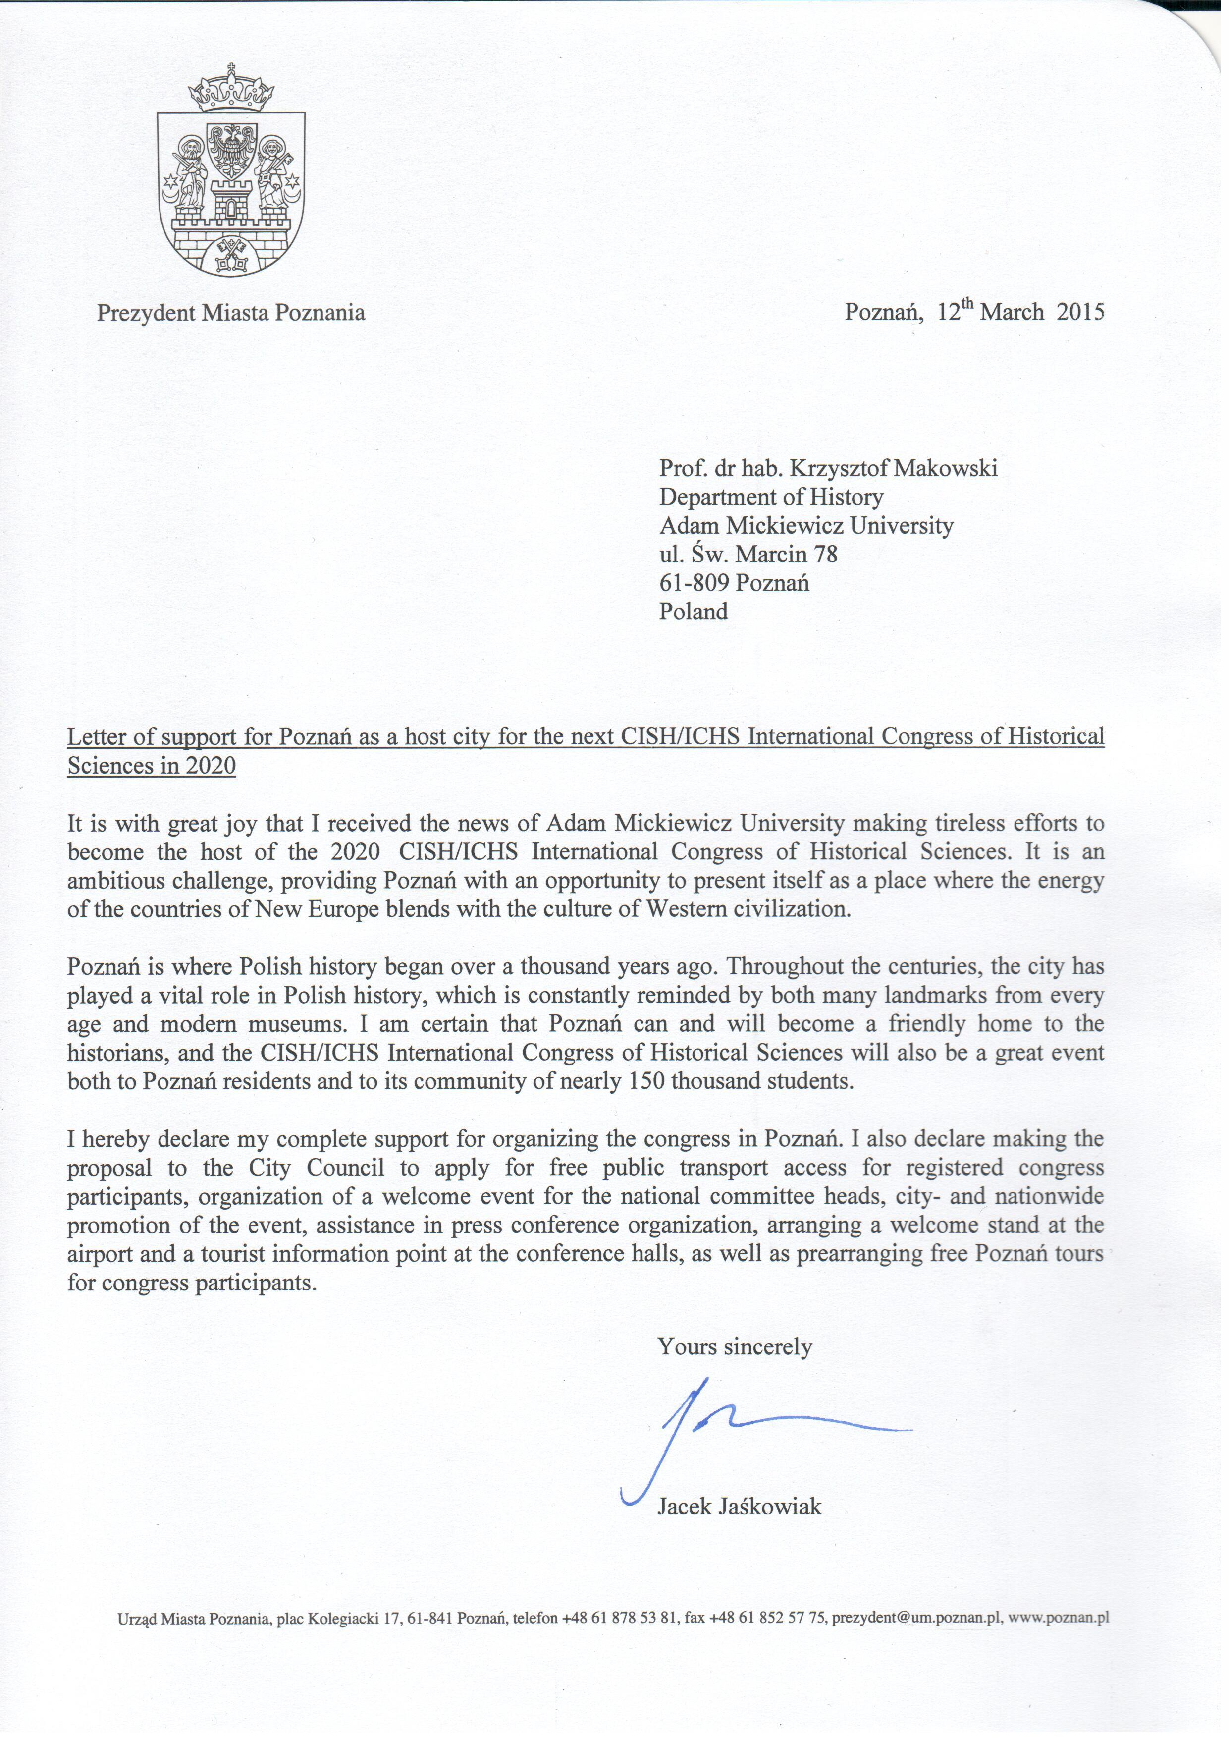
LETTERS OF SUPPORT
N

Slide 6
OPŁATY REJESTRACYJNE

Slide 7
JINAN 2015
Presenting the candidacy of Poznań: Prof. Ewa Domańska and Prof. Tomasz Schramm

Slide 8
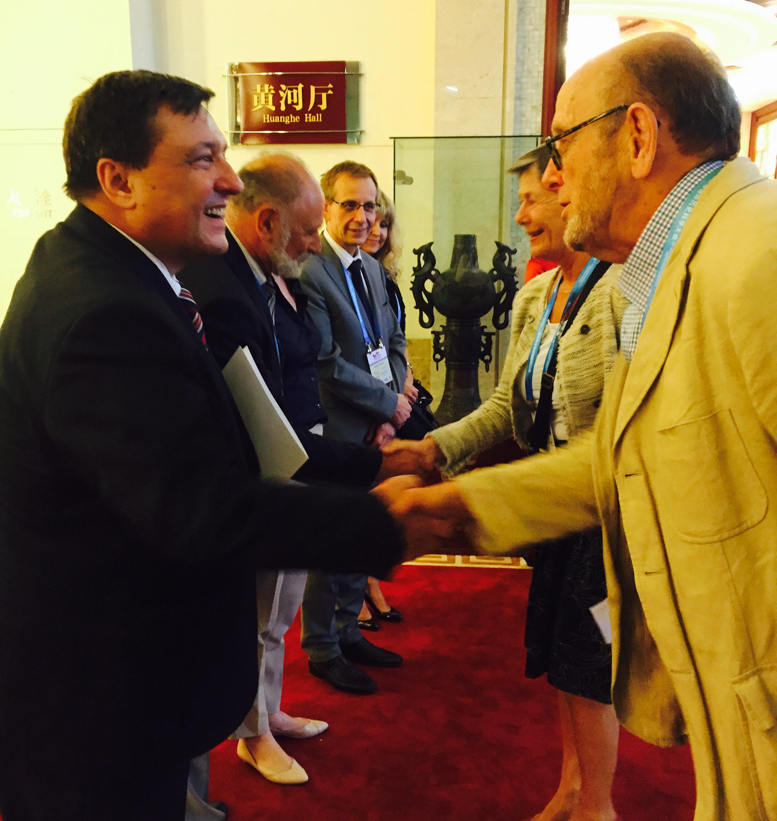
Jinan 2015

Slide 9
Jinan 2015
On August 29, 2015, at the XXII International Congress of Historical Studies in Jinan (China), the General Assembly of ICHS elected Poznań for the host of the XXIII Congress in 2020.

Slide 10
organizational structure

Slide 11
pco

Slide 12
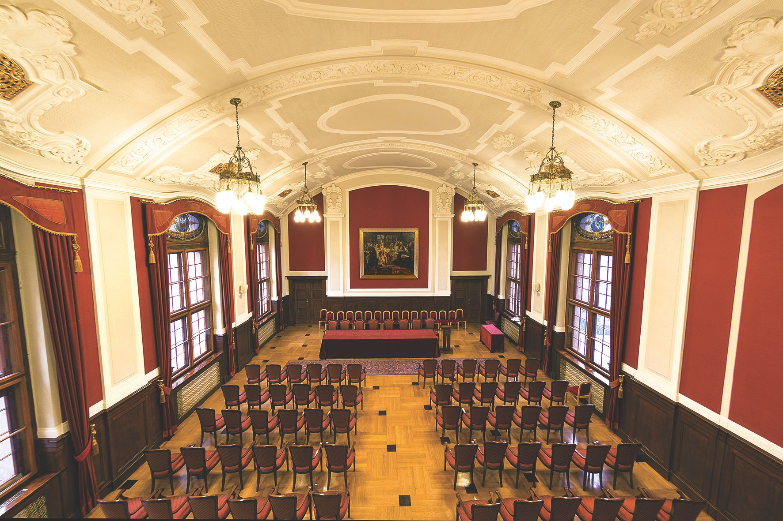
Halls
Lubrański Hall
University Auditorium

Slide 13
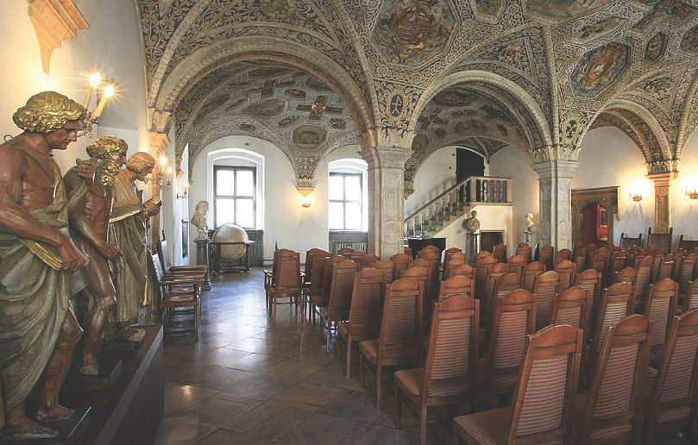
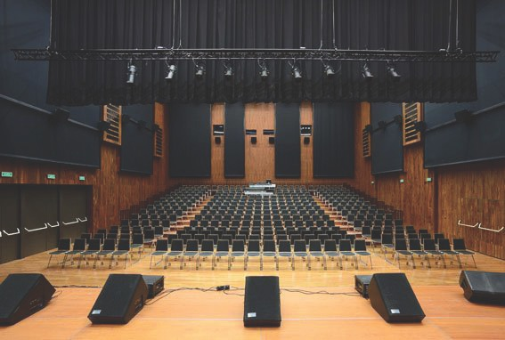
Halls
PIF Earth Hall
Grand Hall of the Town Hall
Great Chamber
in the Culture Centre Zamek

Slide 14
ATTRACTIONS
special offer for the Congress guests in Poznań’s museums, libraries and archives
tours and trips
cultural program

Slide 15
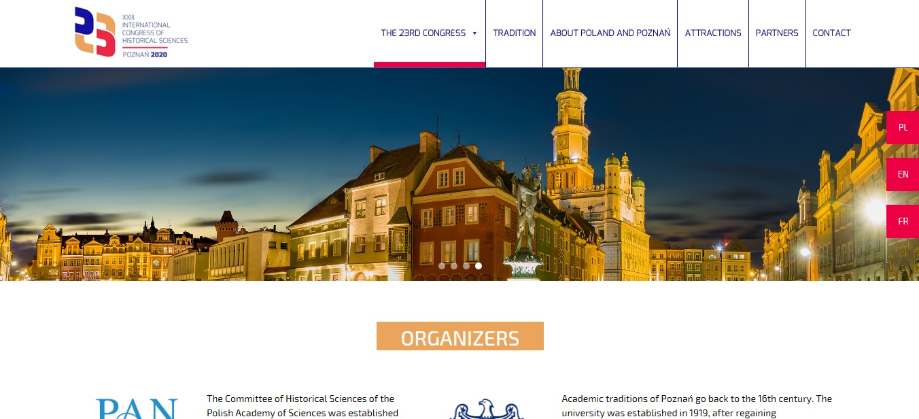
website
www.ichs2020poznan.pl

